Slide 1


Testing the correlation between population age and national economic growth
Presenter: Forest Kingfisher
Presented at Texas Tech University: Department of Industrial Engineering

Slide 2

Population Age hypothesis
“A central factor in every growth story that accompanies industrialization is that much of the economic growth comes from a swelling population.” (Zeihan, 2022, p.56)
“Most of the spending a person does occurs between the ages of fifteen and forty-five– that’s the life window when people are buying cars and homes and raising children and seeking higher education. Such consumption-led activity is what drives an economy forward …” (Zeihan, 2022, p. 54)

Slide 3
The Italian “Post-World War II economic miracle” 1960-2007 (World Bank, 2021)

Slide 4
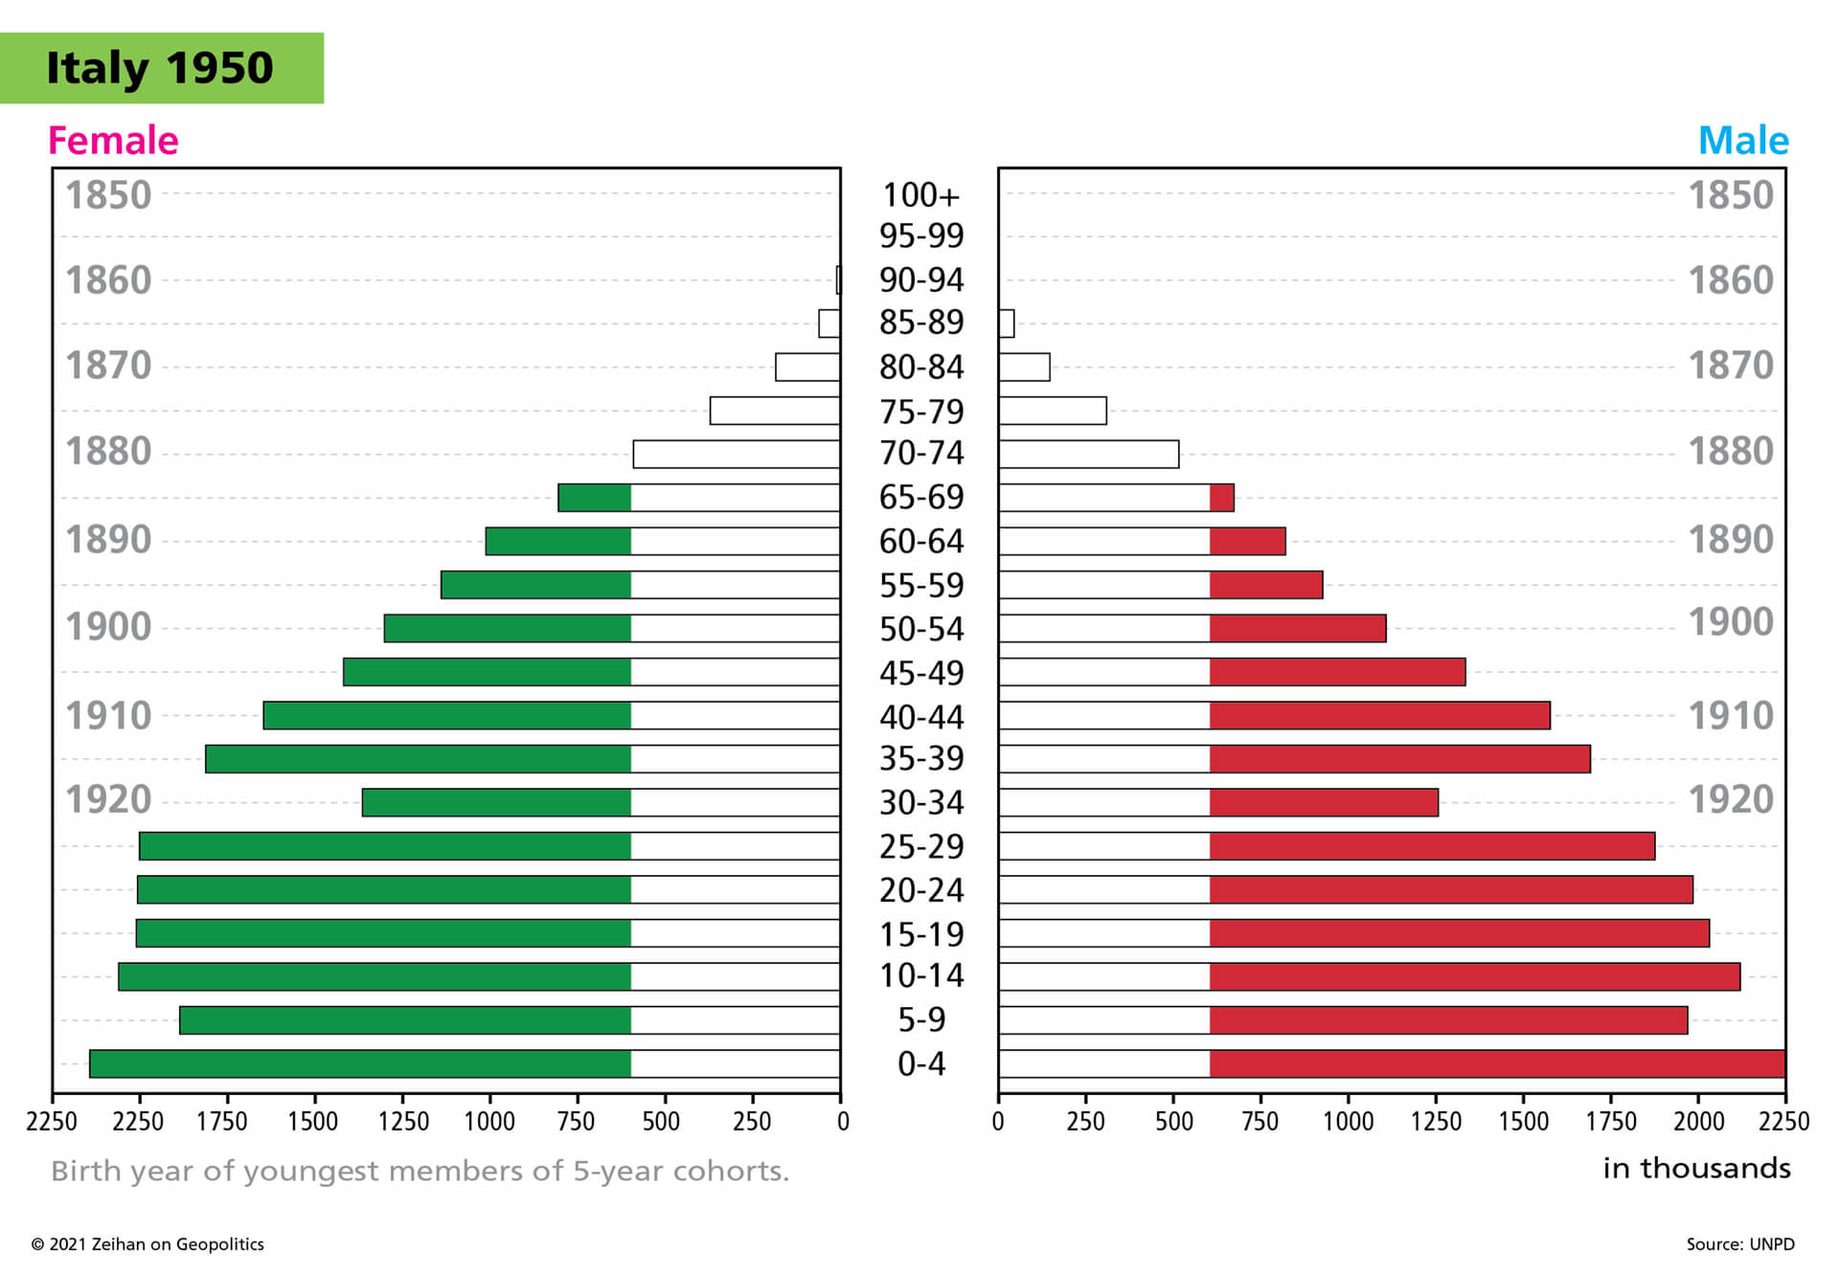
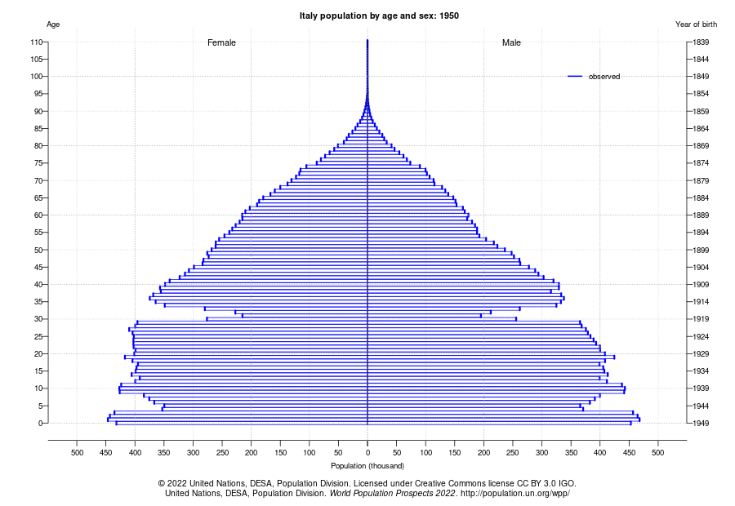
Ideal age demographics for economic growth, Italy 1950 Mean age: 31 Median age: 28
Zeihan’s chart
UN Population Division chart

Slide 5
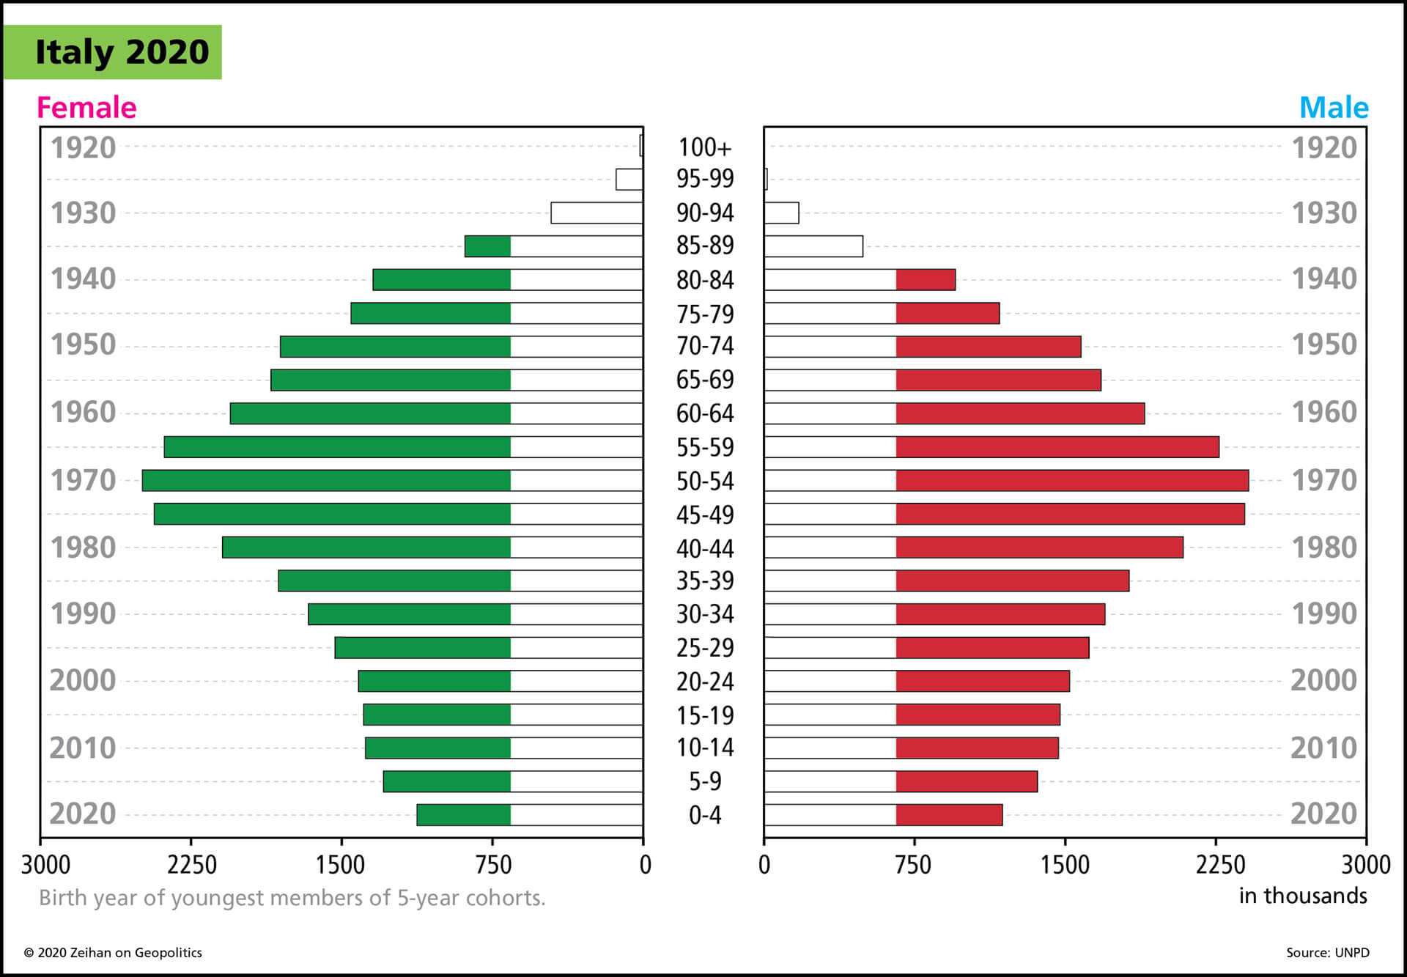
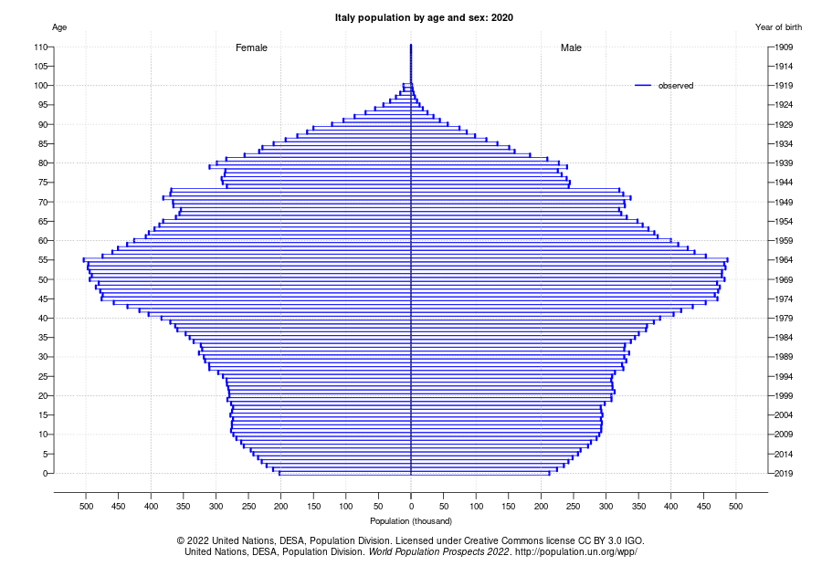
Age demographics that cannot predict growth, Italy 2020 Mean age: 45 Median age: 46
Zeihan’s chart
UN Population Division chart

Slide 6
% GDPPC change per year - vs. - % population change
Not significant
No factors p < 0.15
R-Squared < 0.001 for all linear fits

Slide 7
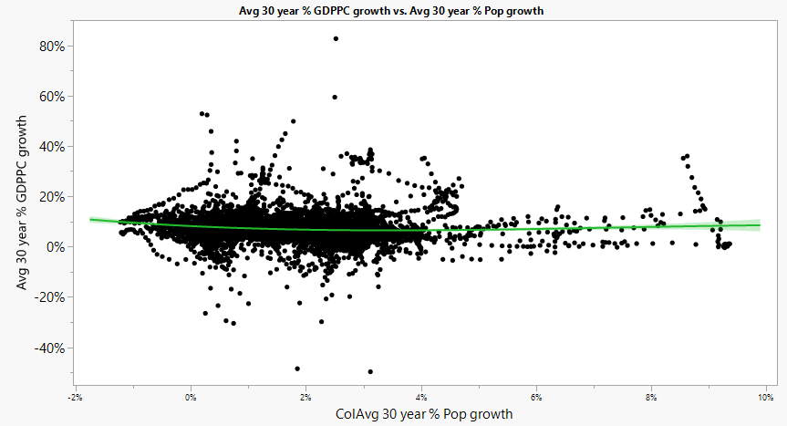
Average GDPPC % growth vs. avg % population growth, all 30-year spans in all countries
R-squared: 0.012
1.2% determination
All factors significant

Slide 8
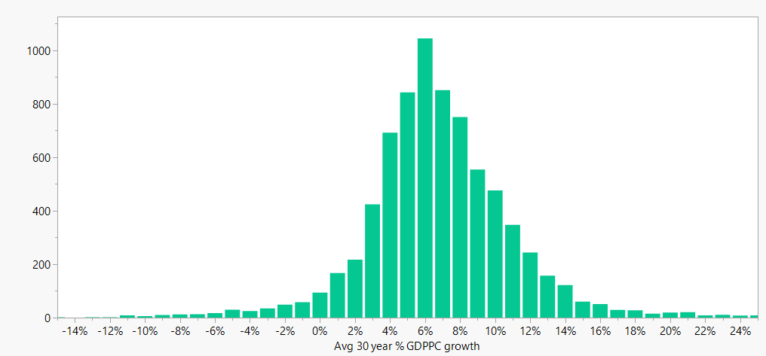
How to lie with statistics, part 1: Determining above average growth
>6.4%

Slide 9
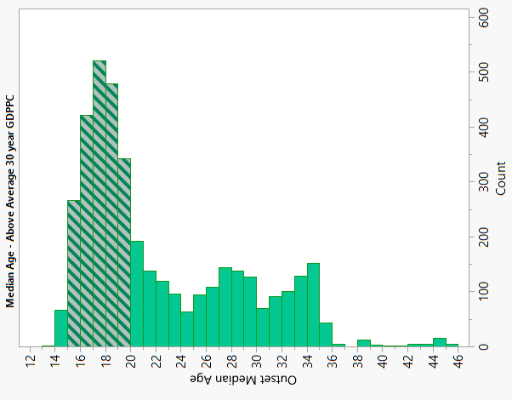
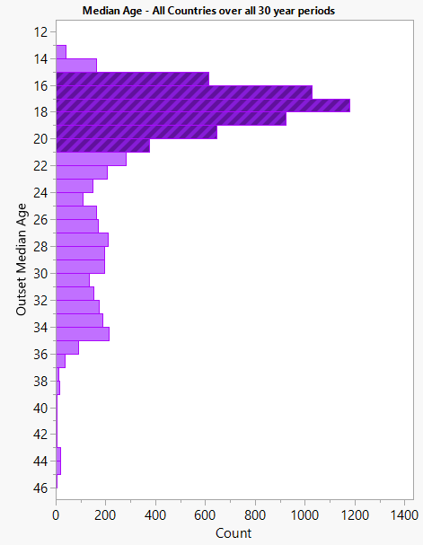
How to lie with statistics, part 2: younger median ages means above average growth!
(false)

Slide 10
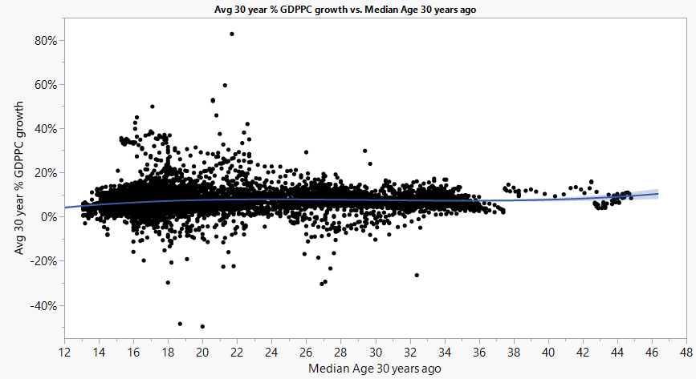
Cubic Linear Fit: all countries each year 1960-2021 Average 30-year growth %, given median age
R-squared: 0.013
1.3% determination
All factors significant

Slide 11
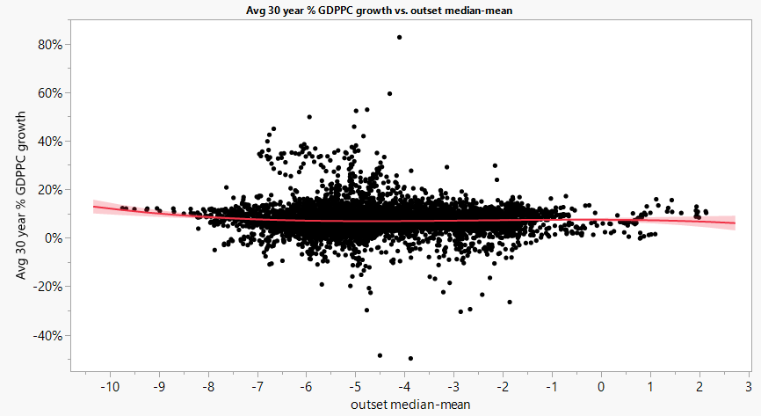
Cubic Linear Fit: all countries each year 1960-2021 Average 30-year GDPPC growth %, by mean-median age
R-squared: 0.005
0.5% determination
All factors significant

Slide 12
References
World Bank (2021)., GDP per Capita https://data.worldbank.org/indicator/NY.GDP.PCAP.CD?view=chart (download links are on the right)
Maddison Project (2022). Comparative Economic Growth statistics https://www.rug.nl/ggdc/historicaldevelopment/maddison/releases/maddison-project-database-2020
United Nations’ Department of Social and Economic Affairs, Population Division (2022), Demographic Indicators dataset from World Population Prospects 2022 https://population.un.org/wpp/Download/Standard/MostUsed/
United Nations’ Department of Social and Economic Affairs, Population Division (2022). Total population (both sexes combined) by single age from World Population Prospects 2022 https://population.un.org/wpp/Download/Standard/Population/

